Slide 1


Complexity Question Detection State of the art
Author: Andrada-Ioana Cojocaru
Thesis advisor: Ș.L.dr.ing. Ștefan Rușeți
BUCHAREST​ 2024​
University Politehnica of Bucharest

Slide 2
Table of contents
01
02
03
Topic
Datasets
Solutions
Presentation on this subject in general.
Description on existing datasets.
The existing solutions and our proposal.

Slide 3
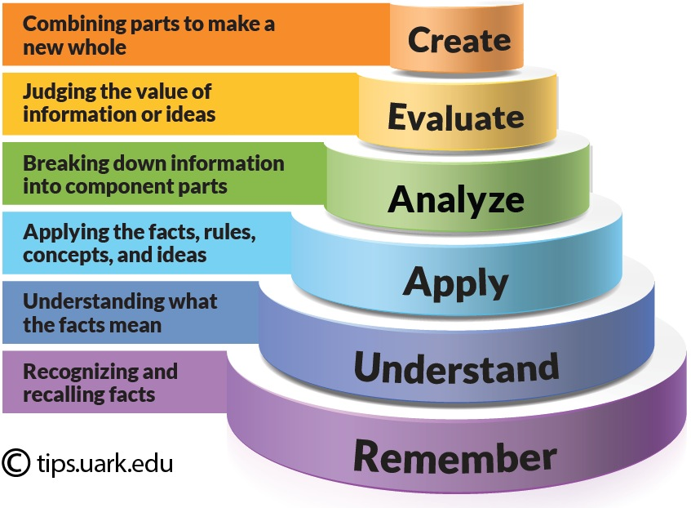
01
Complexity Question Detection using Bloom’s Taxonomy
Problem
Young learners need to understand written texts effectively.
Current methods to assess question difficulty often rely on human judgment or basic metrics.
Solution
Introduce a mechanism to assist in creating questions at varied difficulty levels.
Enables personalized learning by matching questions to each child’s unique needs.
Impact
Supports improved comprehension.
Provides individual challenge levels, fostering better engagement and learning outcomes.

Slide 4
Datasets
02
FairytaleQA
Kopp et al. Dataset
30 texts, each 4–7 paragraphs.
4 Difficulty Levels: Shallow to Deep.
Curated by educational experts to evaluate kindergarten children’s comprehension.
Annotations: Explicit, Implicit, Local, Summary
SQuAD
100,000+ questions from Wikipedia.
Only 770 questions with specific keywords
Zaman et al. Dataset
Dataset of Computer Science Course Queries from Students: Categorized automatically and Scored According to Bloom's Taxonomy
EduQC
3,397 multiple-choice questions.
Labeled manually for cognitive complexity based on Bloom’s Taxonomy.

Slide 5
Existing solutions
03
Dutulescu et al (FairytaleQA)
Ruseti et al(Kopp et al. Dataset)
Model: Flan T5, Qwen 1.5 (Hugging Face).
Method: Zero-shot LLM to assess complexity using QA_loss (cross-entropy).
Process: Sequentially augment context; QA_loss indicates complexity by local minima and unnecessary context.
Models: GRU, BiGRU, LSTM with FastText and GloVe embeddings.
Approach: Matrix G captures similarity with attention vectors.
Ullrich et al (SQuAD)
HADIFAR et al. (EduQG)
Model: 3-layer MLP (64 units, 15 epochs, dropout 0.2).
Outcome: Focused on term-based category classification.
Model: T5 with fine-tuning.
Parameters: Batch size = 8, Total epochs = 10; Learning rate = 5e-5; max source length = 512, max target length = 48; Optimizer: AdamW with weight decay = 0.1, linear scheduler.

Slide 6
Our solution
03
Dataset: Use the EduQC dataset with 3,397 multiple-choice questions annotated by Bloom’s Taxonomy.
Approach:
Apply Chain-of-Thought Prompting on a Large Language Model (LLM).
Analyze responses to determine number of steps or number of words.
Model Testing Process
Question Input: Feed questions from EduQC to the LLM with chain-of-thought prompting.
Classification Accuracy:
Compare model classification to EduQC human annotations.
Adjust prompt to enhance performance for each Bloom’s level.

Slide 7
Bibliographical references
https://reunir.unir.net/bitstream/handle/123456789/14941/cognitive_evaluation_of_examinees_by_dynamic_question_set_generation_based_on_bloom%E2%80%99s_taxonomy_pre-print.pdf?sequence=2&isAllowed=y
https://ieeexplore.ieee.org/stamp/stamp.jsp?arnumber=10051840
https://pdfs.semanticscholar.org/a19d/c13fef60f87231c43c2bde9b4fb4f57359a0.pdf
https://pmc.ncbi.nlm.nih.gov/articles/PMC7081997/
https://www.cedtech.net/download/identification-of-cognitive-learning-complexity-of-assessment-questions-using-multi-class-text-8341.pdf
https://aclanthology.org/2021.icnlsp-1.34.pdf
https://www.sciencedirect.com/science/article/pii/S2352340924000829
https://data.mendeley.com/datasets/w5zt9n6vsc/3

Slide 8
Thanks!
Do you have any questions?
andrada.cojocaru@stud.acs.upb.ro

